Slide 1

Model Development and Inference with Streamlit
Today’s Agenda
Build a basic regression/classification model
Deploy it using Streamlit
Create interactive interface for inference
Learn how to share your model with others
Hands-On Practice
Kahoot(Quiz)

Slide 2
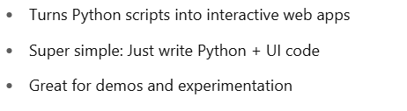
Why Streamlit?

Slide 3
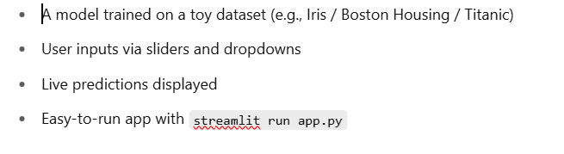
What We'll Build Today

Slide 4
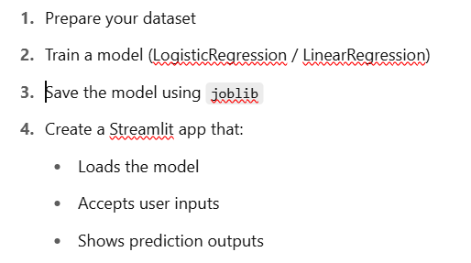
Step-by-Step Process

Slide 5
